Slide 1
MP-0: Platform Introduction
Thomas Smeed, AJ Steenhoek, Sam Ferguson, Christian Williams, Jacob Betsworth

Slide 2
Challenges
Discord
Vivado ILA
Shared folders
Vitis not setting up projects correctly
DAP Error (Can’t program FPGA)
Getting the lab to work in general

Slide 3
Resolutions for Challenges
Discord
Switching computers, working in places with strong internet connection
Vivado ILA
Rereading ILA instructions carefully to learn why it wasn’t working on our initial configuration
Shared folders
Shared a windows folder. Learned to carefully assign permissions and map the folder to the same letter drive on everyone’s computer

Slide 4
Resolutions for Challenges continued
Vitis struggled to set up projects and configure them to platform correctly
Needed to archive Vivado project and relocate to an entirely new directory, then create new Vitis project
DAP Error (Can’t program FPGA)
Power cycle is necessary, so switching VDI machines helps
Getting the lab to work in general
Lots of time spent reading, debugging, implementing, and testing.
Designing based on knowledge from the datasheets is crucial to an effective design

Slide 5
Interesting Aspects/Insights
Take time to learn with the tools yourself
Vivado and Vitus are very powerful tools, but need practical knowledge to make the most of them

Slide 6
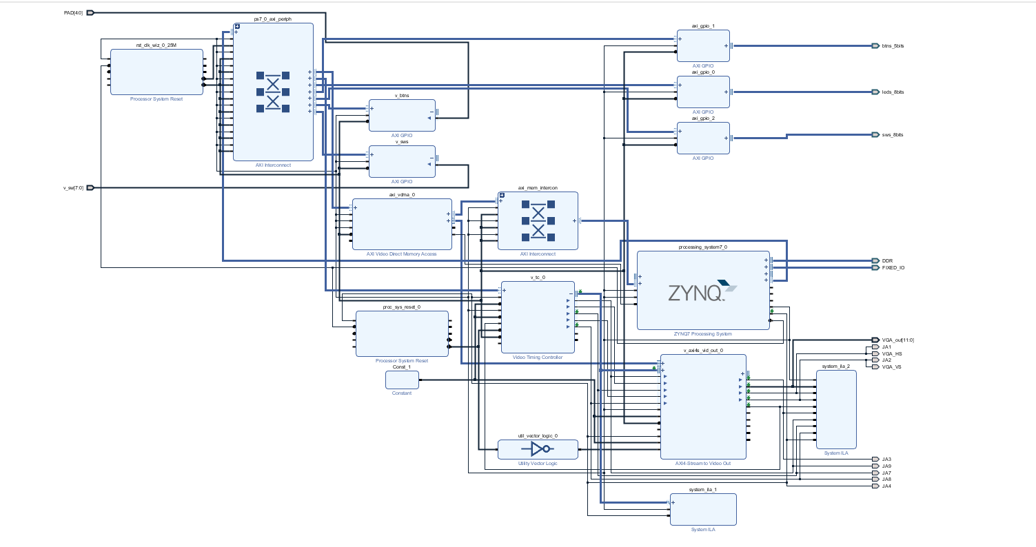
Diagrams

Slide 7
